Slide 1
Naan Mudhalvan Project in Cybersecurity KEYLOGGER
Presented By:
1.Sahana .S –Anjalai Ammal Mahalingam Engineering College

Slide 2
OUTLINE
Problem Statement
Proposed System/Solution
System Development Approach
Algorithm & Deployment
Result (Output Image)
Conclusion
Future Scope
References

Slide 3
Problem Statement
Project problem statement for keylogger Problem Statement: In tokeyloggers, stealthy software tools designed to monitor and record keystrokes on a user's computer without their knowledge. Keyloggers pose a severe threat to individuals and organizations as they can capture sensitive information such as passwords, credit card details, and other personal data, leading to identity theft, financial loss, and privacy breaches.

Slide 4
PROPOSED SOLUTION:
Keylogging Detection: Implementing a system that can detect the presence of keyloggers on a network or device. This could involve signature-based detection, anomaly detection, or behavior analysis.
User Consent and Transparency: Ensuring that any keylogging for legitimate purposes, such as parental control or employee monitoring, is done with clear user consent and transparency.
Ethical Use and Legal Compliance: Establishing strict guidelines for the ethical use of keyloggers, including adherence to privacy laws and regulations.
Security Measures: Incorporating robust security measures to protect the logged data, such as encryption and secure storage, to prevent unauthorized access.
Response Plan: Developing a response plan for incidents where keylogging is detected, which may include alerting users, removing the keylogger, and securing the system.
Education and Awareness: Providing education and awareness programs to inform users about the risks of keyloggers and how to protect themselves.

Slide 5
System Approach
Requirement Analysis
Design
Development
Testing
Deployment
Monitoring and Maintenance
Documentation
Ethical Considerations

Slide 6
Algorithm & Deployment
Initialization: Set up the keylogger to start recording keystrokes.
Keystroke Capture: Use system hooks to monitor and record every keystroke.
Data Storage: Temporarily store the recorded keystrokes in a buffer or file.
Data Encryption: Encrypt the keystrokes to protect sensitive information.
Data Transfer: Send the encrypted data to a secure server or email at regular intervals.
Cleanup: Remove any traces of the keylogger after its execution.
Deployment:
Packaging: Convert the keylogger into an executable file for the target system.
Distribution: Distribute the keylogger through an email attachment, download link, or physical media.
Installation: Execute the keylogger on the target system, either manually or via an exploit.
Execution: Run the keylogger silently in the background without the user’s knowledge.
Monitoring: Remotely monitor the keylogger’s activity and data collection.
Maintenance: Update the keylogger remotely to ensure it remains undetectable

Slide 7
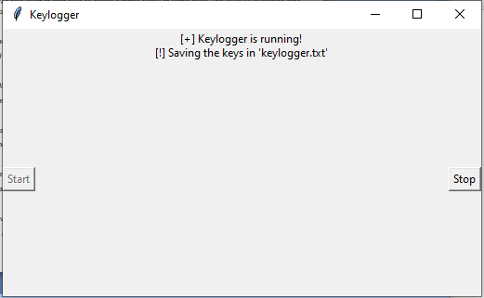
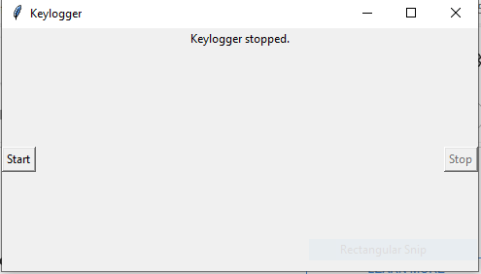
Result
Thus The Keyloggers in cybersecurity are highly effective tools for data capture, often used maliciously to record and transmit sensitive information without detection. Their effectiveness lies in their stealth and the comprehensive data they can collect, posing a significant threat to personal and organizational security

Slide 8
Conclusion
In conclusion, the Keylogger project in Python serves as a valuable educational tool for understanding cybersecurity mechanisms. It highlights the importance of monitoring and logging keystrokes to detect and prevent unauthorized access. However, it also underscores the ethical responsibility of developers to ensure such tools are used legally and with consent, reinforcing the need for robust cybersecurity practices

Slide 9
FUTURE SCOPE
Advanced Data Analytics
User Behavior Analysis
Security Features
Cloud Integration
Real-Time Monitoring
Legal and Ethical Compliance
User Interface Improvements
Cross-Platform Compatibility
Encryption and Anonymization
Customization and Scalability

Slide 10
THANK YOU

